Slide 1
WORLD OF LASERS
Laser Application: Military

Slide 2
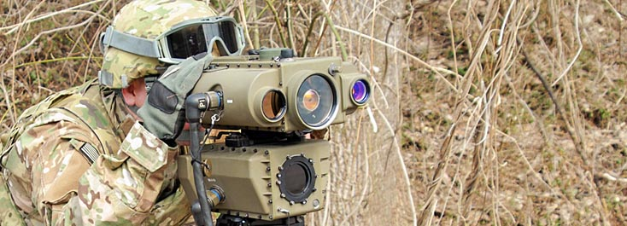
MILITARY
Lasers are used as target designators or laser sights (essentially laser pointers emitting visible or invisible laser beams).

Slide 3
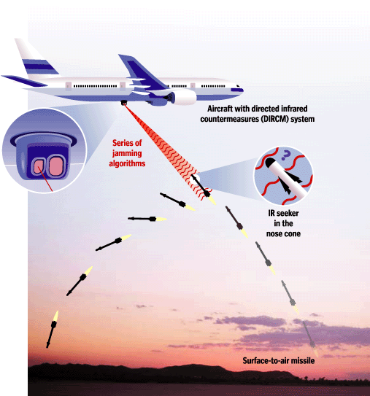
MILITARY
Lasers as irritating or blinding (normally not directly destroying) countermeasures e.g. against heat-seeking anti-aircraft missiles.

Slide 4
?
WELL DONE!
Move on to the next laser application...
HEALTHCARE!

